Slide 1
EE227 – Digital Logic Design
Lecture 26

Slide 2
Outline
Ripple Counters
Binary Ripple Counter
BCD Ripple Counter
Synchronous Counter
Binary Counter
Binary Up/Down Counter

Slide 3
Counters
A register that goes through a prescribed sequence of states upon the application of input pulses is called a counter
Counters are available in two categories
Ripple counters
In a ripple counter, a flip‐flop output transition serves as a source for triggering other flip‐flops
Clock is not common
Synchronous counters
In a synchronous counter, the C inputs of all flip‐flops receive the common clock

Slide 4
Ripple Counters
In a ripple counter, a flip‐flop output transition serves as a source for triggering other flip‐flops
Clock is not common
We will discuss two types of ripple counters
Binary Ripple Counter
A counter that follows the binary number sequence (0, 1, 2, 3, …)
BCD Ripple Counter
A BCD counter follows a sequence of 10 states and returns to 0 after the count of 9

Slide 5
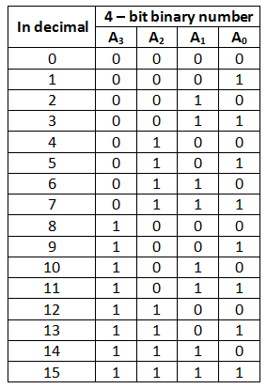
4 – Bit Binary Ripple Counter (1/2)
4 bits → 4 flip flops are required
LSB (A₀) is complementing every time
Connect the flip flop producing A0 directly to a clock
A₁ is changing when A₀ changes from 1 to 0 (at negative edge)
A₀ is connected to the clock of flip flop producing A₁
A₂ is changing when A₁ changes from 1 to 0 (at negative edge)
A₁ is connected to the clock of flip flop producing A₂
A₃ is changing when A₂ changes from 1 to 0 (at negative edge)
A₂ is connected to the clock of flip flop producing A₃

Slide 6
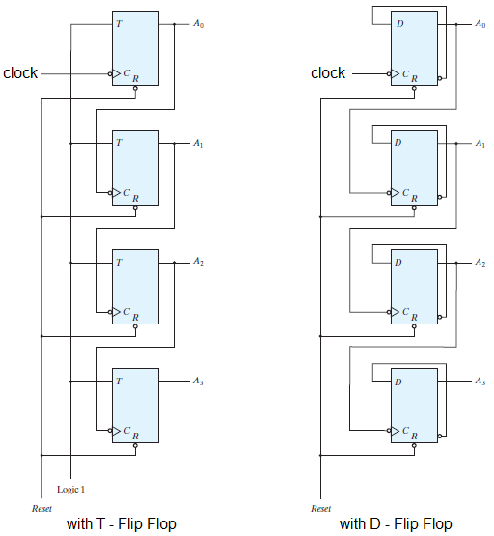
4 – Bit Binary Ripple Counter (2/2)

Slide 7
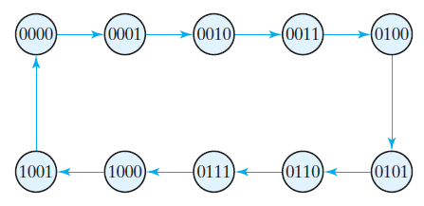
BCD Ripple Counter (1/3)
A BCD counter follows a sequence of 10 states and returns to 0 after the count of 9
10 states → at least 4 flip flops are required
State diagram is shown below

Slide 8
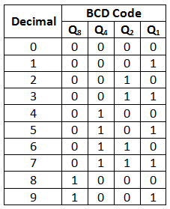
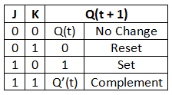
BCD Ripple Counter (2/3)
Q₁ is complemented on every clock pulse
Q₂ is complemented if Q₈ = 0 and Q₁ goes from 1 to 0
Q₂ is clear if Q₈ = 1 and Q₁ goes from 1 to 0
Q₄ is complemented if Q₂ goes from 1 to 0
Q₈ is complemented Q₁ goes from 1 to 0
Q₈ is cleared if either Q₄ or Q₂ is 0 and Q₁ goes from 1 to 0

Slide 9
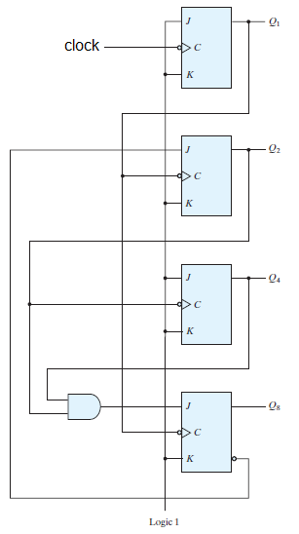
BCD Ripple Counter (3/3)

Slide 10
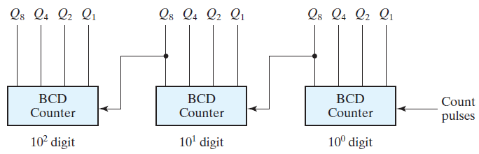
BCD Decade Counter
The BCD counter discussed previously is a decade counter as it counts from 0 to 9
To count in decimal from 0 to 99, we need a two‐decade counter
To count from 0 to 999, we need a three‐decade counter
Multiple decade counters can be constructed by connecting BCD counters in cascade, one for each decade

Slide 11
Synchronous Counters
Synchronous counters are different from ripple counters in that clock pulses are applied to the inputs of all flip‐flops
A common clock triggers all flip‐flops simultaneously, rather than one at a time in succession as in a ripple counter
The design procedure for synchronous counters was presented in chapter 5, and the design of a three‐bit binary counter was carried out
Here we will enhance the design for 4 bit binary counter

Slide 12
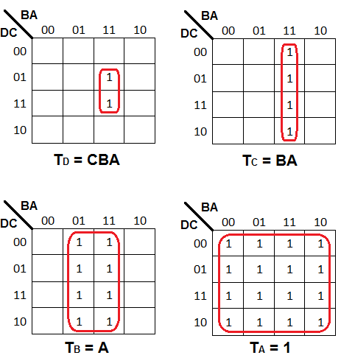
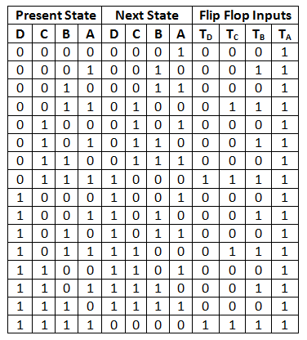
4 – Bit Synchronous Binary Up Counter

Slide 13
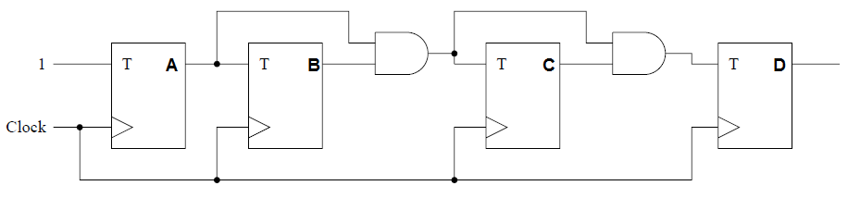
4 – Bit Synchronous Binary Up Counter

Slide 14
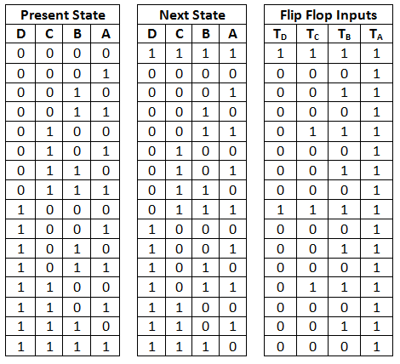
4 – Bit Synchronous Binary Down Counter
From State Table, we get
T_{D} = A’B’C’
T_{C} = A’B’
T_{B} = A’
T_{A} = 1

Slide 15
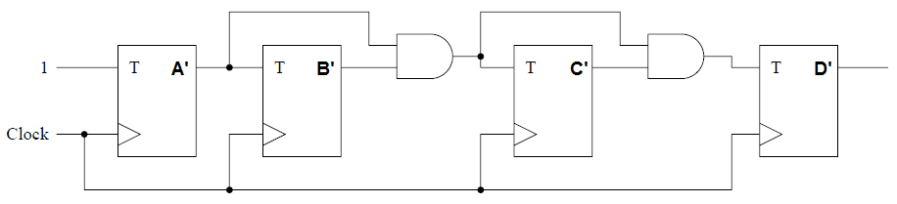
4 – Bit Synchronous Binary Down Counter

Slide 16
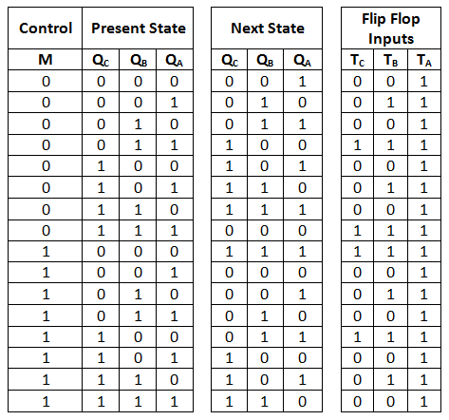
3 Bit Binary Up/Down Counter (1/2)
By using K – Map
We Get
T_{A} = 1
T_{B} = M’Q_{A} + MQ’_{A}
T_{C} = M’Q_{B}Q_{A} + MQ’_{B}Q’_{A}

Slide 17
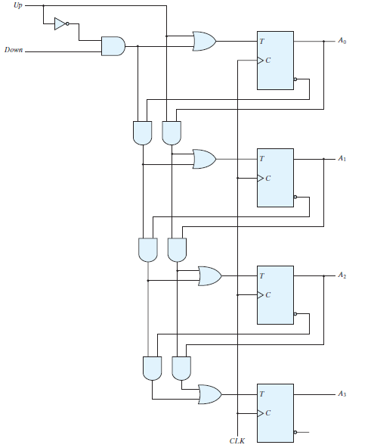
4 Bit Binary Up/Down Counter

